Slide 1
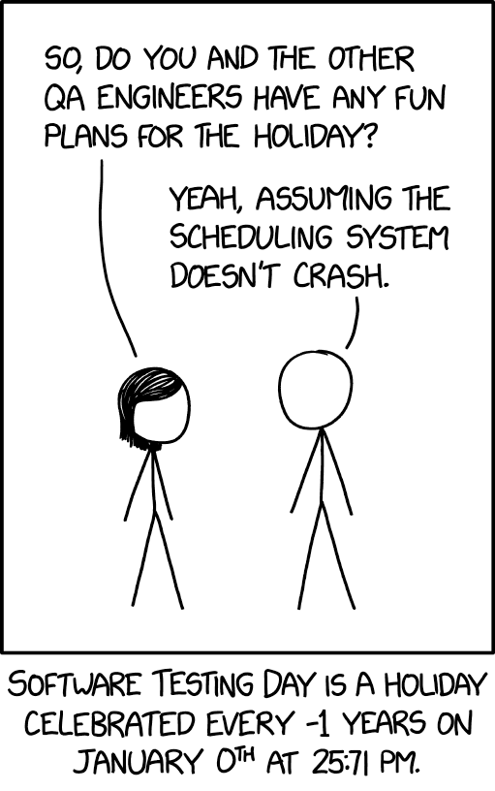
Software Engineering
Testing

Slide 2
Testing Software
If it's not tested, it doesn't work: Bugs can happen anywhere
Many types of testing, highest level division is:
Manual testing: an actual person fires everything up and starts using it
Usability testing
Exploratory testing
Visual testing (can be automated, but expensive)
Automated testing: software runs through a suite of programmed tests
Regression testing
Unit testing
Failure testing
Performance testing

Slide 3
Regression Tests
Most common type of test
Three main categories:
Unit tests: Test a single component (one API); often use mocks to replace other components
Ex: prototype tests
Integration tests: Test a combination of several components, but not necessarily user-visible endpoints
Ex: Check that a server can work with an actual database
End-to-end tests: Start with a (simulated) user action, check the user-visible result, running through the whole system
Ex: Run an install script and check that servers can start up after being installed

Slide 4
Writing Tests: JUnit
To run a java program: Use a main method
To run a java test: Use an @Test annotation
import static org.junit.jupiter.api.Assertions.fail;
import org.junit.jupiter.api.Test;
public class ExampleTest {
@Test
public void testAddition() {
int a = 2;
int b = 3;
if (a + b != 5) {
fail();
}
}
}

Slide 5
Writing Tests: JUnit
import static org.junit.jupiter.api.Assertions.fail;
import org.junit.jupiter.api.Test;
public class ExampleTest {
@Test
public void testAddition() {
int a = 2;
int b = 3;
if (a + b != 5) {
fail();
}
}
}
'static' import: Allows importing methods/constants instead of an entire class

Slide 6
Writing Tests: JUnit
import static org.junit.jupiter.api.Assertions.fail;
import org.junit.jupiter.api.Test;
public class ExampleTest {
@Test
public void testAddition() {
int a = 2;
int b = 3;
if (a + b != 5) {
fail();
}
}
}
JUnit 4 vs JUnit 5: to use the more up-to-date/widely supported version, make sure to import org.junit.jupiter, not regular org.junit

Slide 7
Writing Tests: JUnit
import static org.junit.jupiter.api.Assertions.fail;
import org.junit.jupiter.api.Test;
public class ExampleTest {
@Test
public void testAddition() {
int a = 2;
int b = 3;
if (a + b != 5) {
fail();
}
}
}
JUnit is a heavily annotation-based framework - @Test is the most common, but there are others (ex: @BeforeEach)

Slide 8
Writing Tests: JUnit
import static org.junit.jupiter.api.Assertions.fail;
import org.junit.jupiter.api.Test;
public class ExampleTest {
@Test
public void testAddition() {
int a = 2;
int b = 3;
if (a + b != 5) {
fail();
}
}
}
When a test class runs, it will run all methods with @Test as separate tests.
A test fails if it throws an Exception, Error or other Throwable (fail() throws an AssertionError). Otherwise, it succeeds

Slide 9
Your Turn!
You'll want a project for following along for today, so let's get that configured now
Follow the Testing Exercises link on Brightspace, and open with Github Desktop (or preferred git client)
From the command line in the repo folder, run ./gradlew eclipse
Copy the ExampleTest class from the previous slide into a new file in a test folder in your repo (TestingExercises/test/ExampleTest.java)
Check that ExampleTest compiles and runs
Note: you may need to change the junit-jupiter version in build.gradle, depending on what Eclipse version you have - you can get Eclipse to tell you what it expects (go through the steps of adding JUnit 5 as a library to your build path, but don’t actually add it, just grab the version info on the penultimate step)

Slide 10
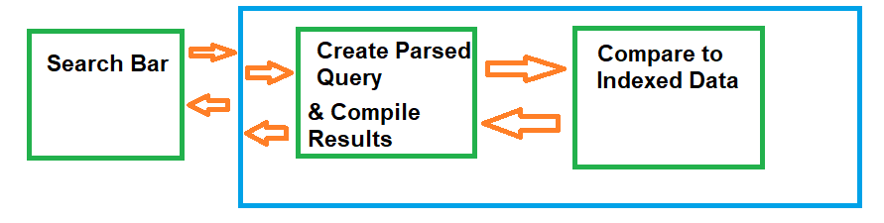
When To Use Which Type of Test
Remember the System Design Diagram from last week.
Suppose you write all the code, fire it up, and the search bar doesn't do anything.
What's broken?

Slide 11
Unit Tests: Something is Wrong Inside a Box
Recall: a unit test tests just one component
If something is wrong with just the search bar, a unit test for the search bar will fail

Slide 12
Integration Tests: Something is Wrong Between Boxes
Recall: an integration test tests multiple components (usually 2)
If something is wrong with sending a parsed query to the indexed data, that will cause an integration test to fail

Slide 13
End-To-End Tests: Something is Wrong Systematically
Recall: an end-to-end test checks an entire workflow
If all integration and unit tests are passing, an end-to-end failure will flag systemic issues (ex: SSL configuration mismatch)

Slide 14
Unit Tests: Just What's in One Box?
How to test that 'search results display correctly' while only using code from the 'Search Bar' component?

Slide 15
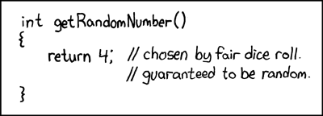
Mock Objects
In order to isolate just one component for testing, use mock objects for other components
In-memory
Dummy implementation (hardcoded return values for methods)
No side effects
Test-code only (often single-test only)

Slide 16
Mock Objects
import org.mockito.Mockito;
import static org.mockito.Mockito.when;
import static org.mockito.Mockito.any;
Common Framework: Mockito
Many other interesting methods that you can statically import!
Note: Most IDEs don't have good support for automatic static import detection; you may need to do this part by hand

Slide 17
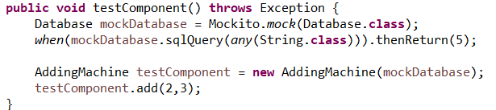
Mock Objects
Creating the mock object: Mockito.mock()
Interfaces
Non-final classes

Slide 18

Mock Objects
Dummy implementation: tell the mock how it should respond to requests
Anything left unspecified will return default values and do nothing

Slide 19

Mock Objects
Use the mock to create a real version of the component to test
Everything else except that one component is mocked

Slide 20
Your Turn!
Look at the exercise1 package in the TestingExercises project
Within that, you'll find a class Widget and an interface Foo
Write a test for the Widget class that uses a mock Foo object, and verifies that calling addNumbers(2,3) does not throw an Exception

Slide 21
To the IDE!

Slide 22
Internet Advice Caution
Mockito.verify is often recommended (including in Mockito docs) online; don't use this for unit tests/smoke tests
Annoying to configure
Encourages bad testing practices (change-detection tests vs behavior tests)
Good for some highly specific use cases (in particular, it’s good for convincing devs with established code bases to migrate to Mockito)
Advantage of Mockito over other mock frameworks (EasyMock, JMock) is that you can easily avoid calling verify
Look at the "stub method calls" examples instead

Slide 23
JUnit Assertions
public void testAddition() {
int result = new AddingMachine().add(2,3);
Assertions.assertEquals(5, result);
}
JUnit: test fails ⇔ test throws an Exception
Test logic: test fails ⇔ some condition is not met
Assertions translates between the two: if the two values to assertEquals aren't equal, throws AssertionFailedError
Many, many methods available (arrayEquals, lessThan, greaterThan, etc)
Version note: in Junit 4, this class was called Assert. You can almost always directly replace Assert.<method> with Assertions.<method> to convert to Junit 5

Slide 24
Test Driven Development (TDD)
Write tests as you go along:
Write the API (the prototype will often be the first test)
Write some simple unit and integration tests (smoke tests)
Write the code
Write bug-driven tests (unit and integration)
Remember: a good test always needs to fail at first

Slide 25

Test Driven Development (TDD)
Smoke tests (where there's smoke there's fire):
Specific type of unit test
Check that all basic operations work for normal input
Does not need to handle edge cases or complex cases
Example:
public void testAddition() {
int result = new AddingMachine().add(2,3);
// old-school alternative to Assertions
assert result == 5;
}

Slide 26

Failure Testing
Use tests to trigger unusual error states
File system failures
Networking failures
More generally, any failure from another component's API

Slide 27

Failure Testing
For simple cases, use a mock object:
Mockito.thenThrow

Slide 28

Failure Testing
But what if you need something more fully featured than a mock?
Add testing hooks in your code
These are no-op methods designed for tests to override them to inject functionality
Combine these with a test implementation
Fully functional (unlike a mock)
Allows for failure testing in integration tests

Slide 29
Failure Testing
public class ServerConnection {
public Connection getConnection() {
testingHook();
return connection;
}
protected void testingHook() {
// does nothing, only implemented by tests
}
}
public class ServerTestSuite {
private boolean hasFailed = false;
private static class TestServerConnection extends ServerConnection {
protected void testingHook() {
if (!hasFailed) {
hasFailed = true;
throw new ServerConnectionException();
}
}
}

Slide 30
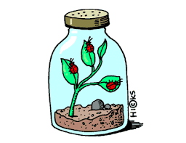

Bug-Driven Testing
Use tests to reproduce a bug in a controlled environment

Slide 31
Bug-Driven Testing
Happens after implementing code
Either actual reported bugs, or suspected bugs:
Edge cases
Unusual code paths
Combine with TDD smoke tests to get good testing coverage

Slide 32
Testing Coverage
Test Coverage is the percentage of branches and lines of code that are exercised by test code
Ideally, all lines of code would be tested; in practice, that's often excessive/not useful
Ex: an assert statement that never fails
Aim for 80-90% code coverage

Slide 33
Testing Coverage Tools
Recommended: JaCoCo (https://www.eclemma.org/jacoco/)
Originated from the Emma project (https://emma.sourceforge.net/), which is no longer well-maintained
Includes IDE plugins for both IntelliJ and Eclipse
https://plugins.jetbrains.com/plugin/103-emma-code-coverage
https://www.eclemma.org/

Slide 34
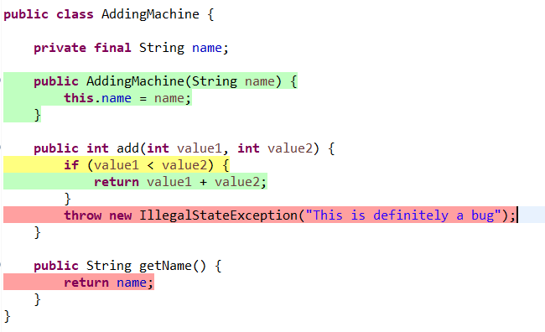
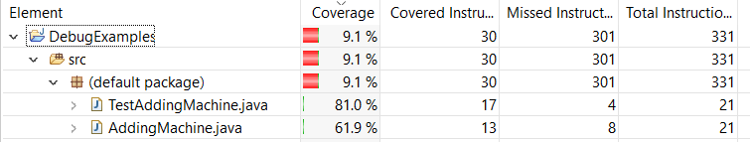
Testing Coverage
Sample Coverage Output
@Test
public void testAddition() {
int result = new AddingMachine().add(2,3);
Assertions.assertEquals(5, result);
}

Slide 35
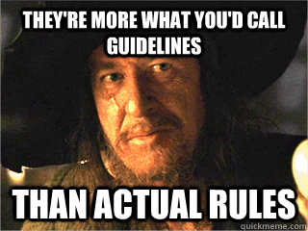
Using Test Coverage Output
80% coverage is fine
Focus on quality of tests more than coverage numbers
Use the output to spot problem areas/missing testing

Slide 36

Fuzz Testing
A version of automated exploratory testing
Uses randomization to test out unexpected paths
Randomization in tests must be done carefully, or the tests stop
being useful:
For each test run, print the seed used for the random number generator
Allow a manual run to specify a seed
This lets you have repeatable tests, which is critical for identifying and fixing bugs

Slide 37
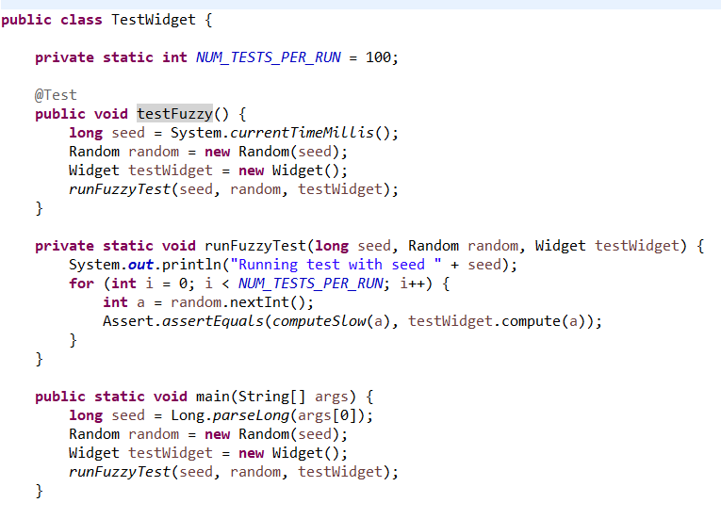
Fuzz Testing Example

Slide 38
Your Turn!
Check out the exercise2 package in TestingExercises
Run the tests, check that the basic smoke test passes
Using the checkComputation method, write a fuzzy test that will add lots of different random integers
Using the fuzzy test, find an input that triggers the bug in AddingMachine.java

Slide 39
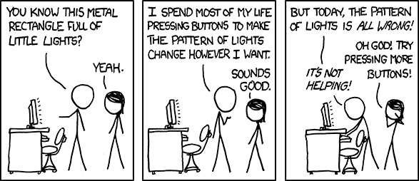
Software Engineering
Debugging

Slide 40
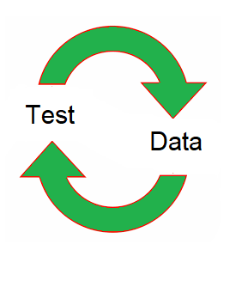
Debugging Philosophy
Quick iteration is key
Prefer many tests that each check one small feature
Code complexity is quadratic with lines of code
Finding a bug is a search problem

Slide 41

Design for Debugability
Keep state as local as possible
Local variables
Parameters
Private data
Public data

Slide 42
Design for Debugability
Make shared data immutable wherever possible
Example: Builder pattern
WidgetBuilder newWidget = new WidgetBuilder();
newWidget.setSpinnerSpeed(getSpinnerSpeed());
newWidget.setNumberOfGears(numGears);
return newWidget.build();

Slide 43
Design for Debugability
Create wrapper classes to keep code logic in one file
public class WidgetCache {
private Map<Long, Widget> idToWidgetCache = new HashMap<>();
public Widget put(long id, Widget widget) {
return idToWidgetCache.put(id, widget);
}
public Widget get(long id) {
return idToWidgetCache.get(id);
}
public void clear() {
idToWidgetCache.clear();
}
}

Slide 44
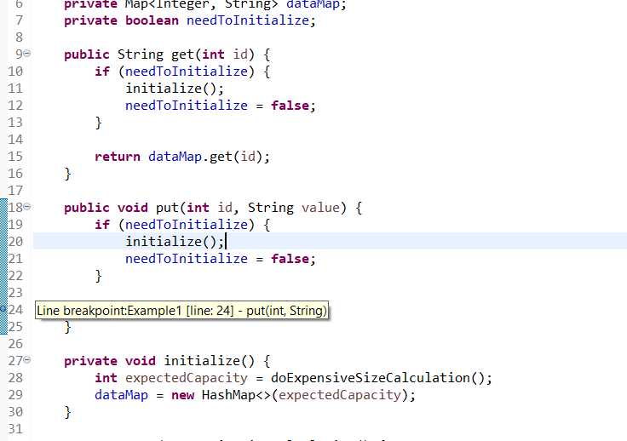
Useful IDE Tools
Breakpoints

Slide 45
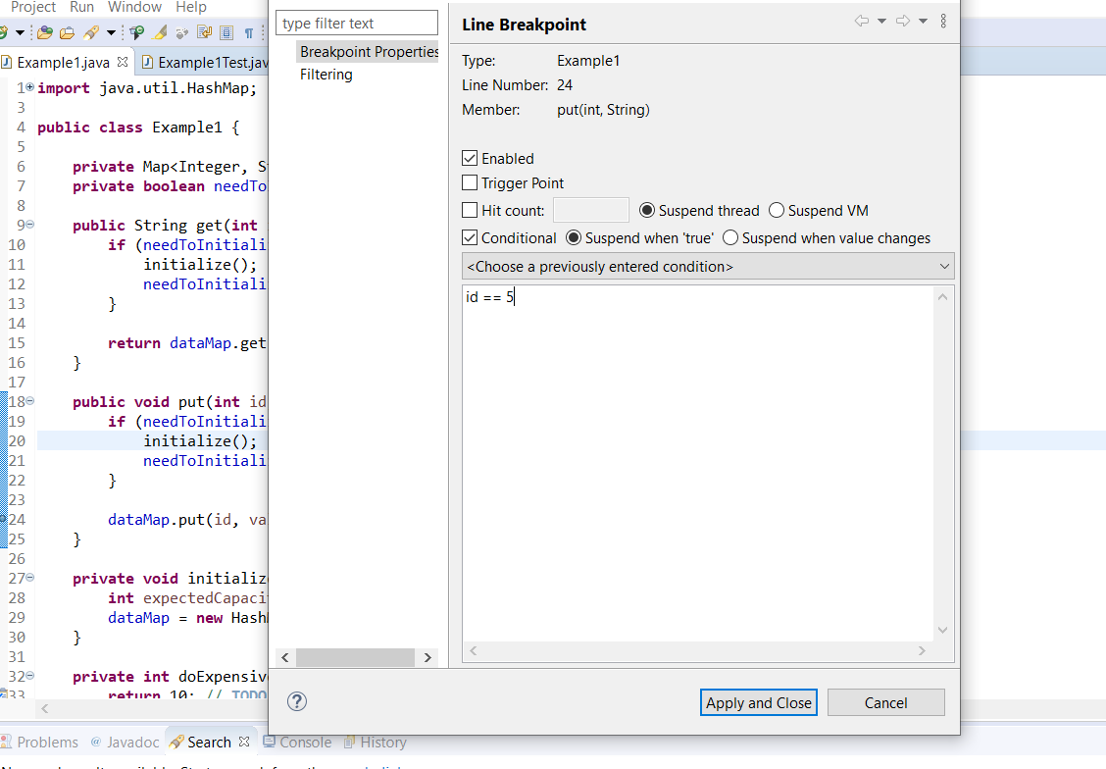
Useful IDE Tools
Conditional Breakpoints

Slide 46
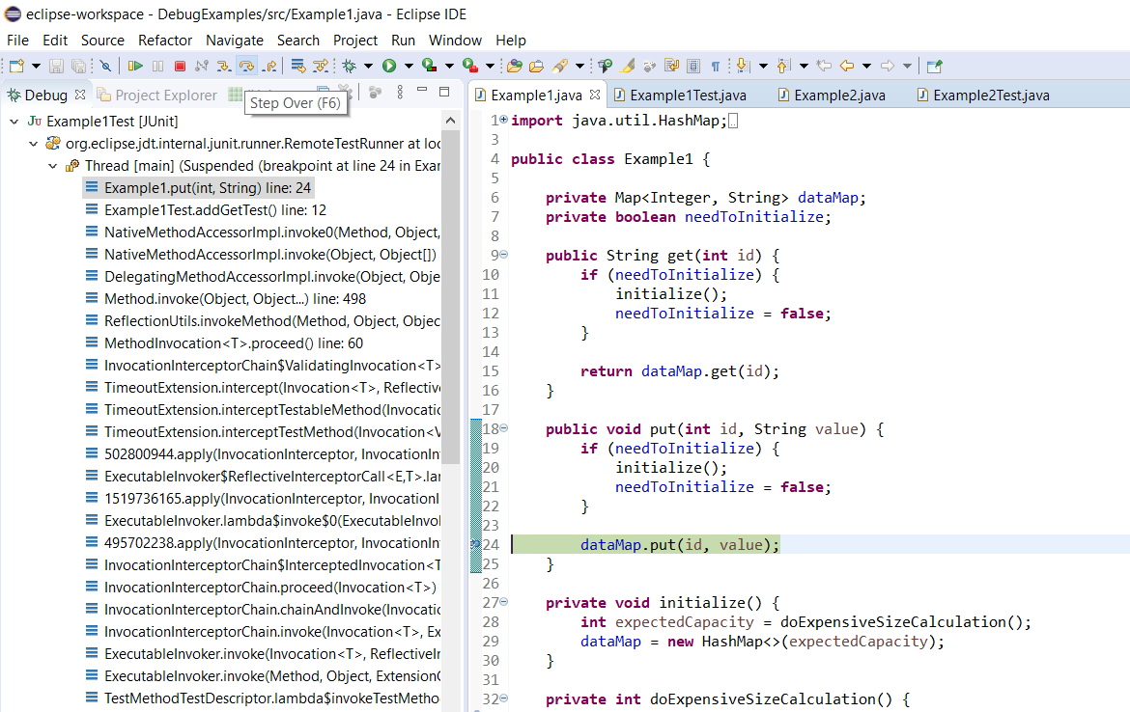
Useful IDE Tools
Control Flow: Step in/out/over

Slide 47
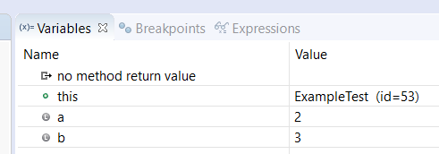
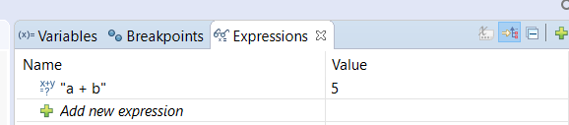
Useful IDE Tools
Tons of useful info available in the debugger
Much faster to examine live vs. println debugging

Slide 48
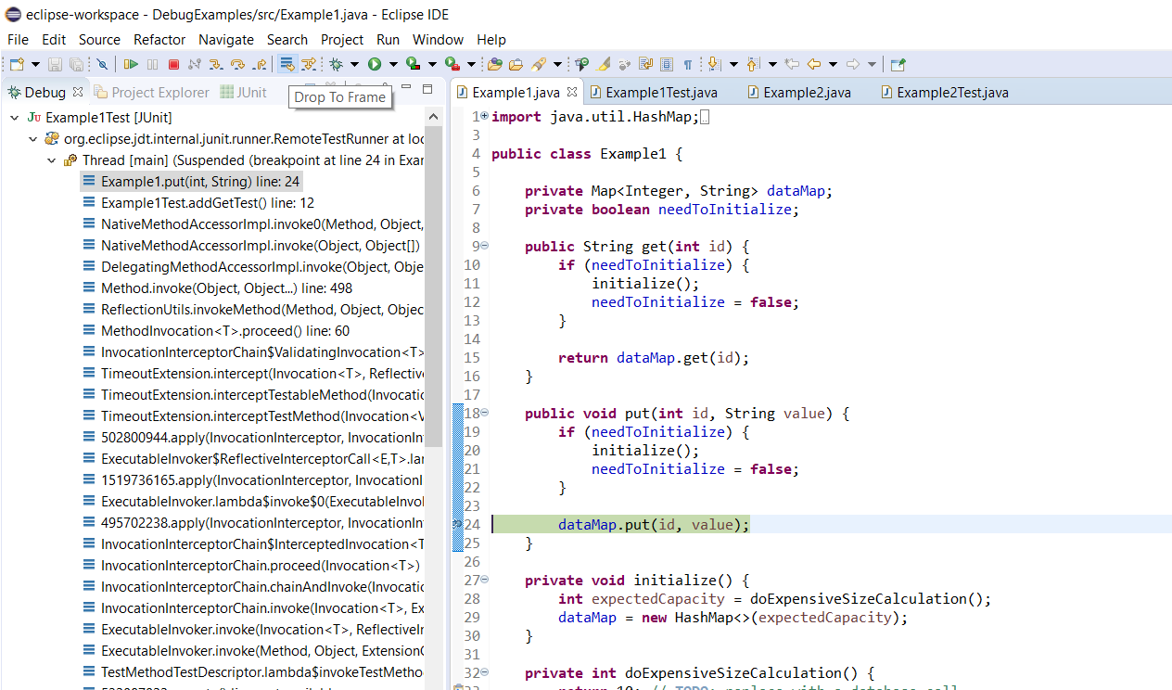
Useful IDE Tools
Drop To Frame (Caution: Does not reset non-local state, such as fields)

Slide 49
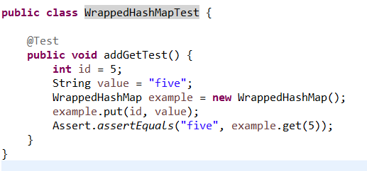
Debugging Example
Build a smoke test first

Slide 50
Debugging Example
public class WrappedHashMap {
private Map<Integer, String> data;
private boolean needToInitialize;
public String get(int id) {
if (needToInitialize) {
initalize();
needToInitialize = false;
}
return data.get(id);
}
public void put(int id, String value) {
if (needToInitialize) {
initalize();
needToInitialize = false;
}
data.put(id, value);
}
private void initalize() {
int initialCapacity = 10;
data = new HashMap<>(initialCapacity);
}
}
Next, write the implementation
We're leaving the cross-component db call unimplemented for the moment
Because we'll have that eventually, though, we need to use lazy initialization
Note that you should never rely on a user to initialize!

Slide 51
Debugging Example
To the debugger!

Slide 52
Debugging Example
Recap of the process:
Put a breakpoint on the failing line
Run through a test that triggers the failure, and check instance and local variable state at the breakpoint
Add a breakpoint where the value of an incorrect variable should have changed
Repeat

Slide 53
Your Turn!
Check out the exercise3 package in TestingExercises
Run the TestCombinatorics test; it should fail
Put a breakpoint at the last line in the stack trace, and see what variables are invalid at that line
Find where the invalid variable should have been set, put another breakpoint there (for method return values, use the 'return' line of the method)
Repeat this process - for breakpoints within for loops, use a conditional breakpoint to only stop the breakpoint when something interesting is happening
Fix the bug, and verify the test is now green

Slide 54
Let's Review (Testing & Debugging)
Two main categories of testing: manual vs automated, what each is good for
Three types of regression testing
What is a mock object and what is it used for
What is a testing hook and what is it used for
What is fuzz testing (...and what is it used for)
What are three ways to design for debugability in your code

